Slide 1
UNION REGIONAL WATER SYSTEMS CONSOLIDATION PUBLIC HEARING
OCTOBER 4, 2016
JOCELYNE GRAY, PE
DIRECTOR OF OPERATIONS-WATER

Slide 2
Water Systems Involved
Union
Union Ridge
Vuecrest
Highland Park
Hood Canal
Alderbrook
Notes:
Six systems involved. We are not including Madrona Beach due to the purchase agreement we have with that system.

Slide 3
Service Area Map
UNION
HOOD
CANAL
UNION RIDGE
HIGHLAND
PARK
VUECREST
ALDERBROOK
Notes:
This shows the existing service areas and the proposed future service areas. The dark areas are the existing service areas. The cream areas are areas within the consolidated Union area that could be served plus the Green Diamond expansion to the east of Alderbrook.

Slide 4
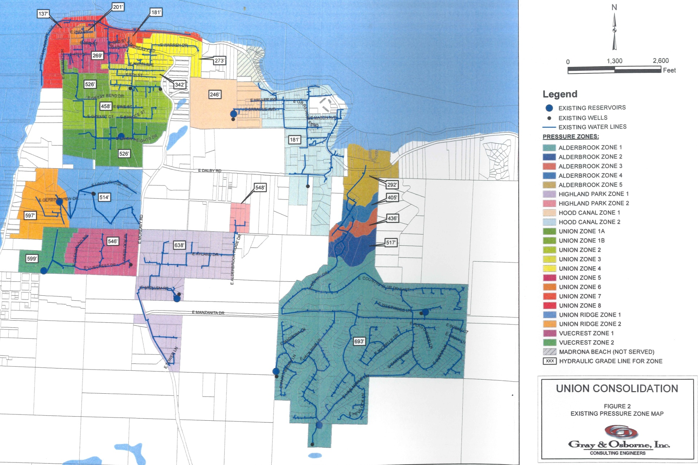
Pressure Zones
Notes:
This shows the pressure zones for each of the existing water systems. Currently there are 22 pressure zones.

Slide 5
Why Consolidate?
Address system deficiencies
Improve water quality
Add redundancies (backup)
Increase efficiency
Plan for future area growth
Notes:
We will discuss the individual system deficiencies in the following slides. Three of the water systems are single source systems with inadequate storage for capacity and emergency outages. Many of the proposed improvements need to be constructed to address capacity issue regardless of consolidation. Consolidation helps us address several issues at once versus addressing the issues system by system.

Slide 6
Individual vs Consolidation
Individual
6 separate funding packages
6 designs in phases
6 separate report sets
Duplicate projects
Does not address lack of redundancy
Less complicated sampling
Consolidation
1 funding package
More points on funding pkg for regional needs
1 design in phases
1 set of reports
Addresses redundancy
Addresses several issues with fewer projects
Cost spread over more connections
Less $/connect
Notes:
There is more loan forgiveness available for consolidated projects.
Now we are going to discuss the individual system deficiencies.

Slide 7
Highland Park System Deficiencies
Waiting list of property owners wanting water connections within Highland Park Plat (21 lots) and outside the plat (4 lots)
Needs additional reservoir storage volume
Booster pumps need to be upsized
Well pump 43 years old
Single source system
Undersized mains (2-inch and 3-inch)
Notes:
Needs 23,034 additional gallons = equalizing storage and standby storage
We do not need to provide fire suppression storage

Slide 8
Highland Park Projects
Project | Unit Cost | Total Cost | Years
Reservoir Repairs | $5,000 | $5,000 | 2017
WSP Update | $10,000 | $20,000 | 2022, 2028
35,300 Gal Tank | $1.80/Gal | $63,540 | 2019
Property for Tank | $75,000 | $75,000 | 2018
Booster Station for Tank | $175,000 | $175,000 | 2018
Brass Meter Replacement for Lead Reduction – convert to AMR | $350/meter | $7,350 | 2020
Main Line Replacement – convert to AMR | $100/ft | $690,000 | 2019-2021
Main Line PRV Replacement | $1,000 ea | $1,000 | 2023
Repaint Booster Station | $2,000 | $2,000 | 2021
Tank Inspection & Cleaning |  | $6,300 | 2018, 2022, 2026
Well Pump Replacement (due to age) | $200/ft | $78,000 | 2018
Total Highland Park 11- Yr CIP |  | $1,123,190 | (69 connections)
Notes:
Governor has declared removal of lead in water systems a priority. Over the next two years we have to identify where we have lead then over the following ten years we have to remove the lead. We have meters with brass containing higher levels of lead than the “low-lead” standard. We are beginning with meters that were installed before 2000. Meter life is about 25 years and we had already planned to begin conversion to AMR for all service meters due to age of the non-AMR meters. All services are now metered so we can focus on the AMR conversion.
The CIP goes out 11 years to capture the second WSP update. DOH is working on the rule change so updates can be every 10 years instead of every 6 years. If it is 10 years, the update is due in 2026.
Slide 21 shows the cost per connection for the 11-yr CIP.

Slide 9
Hood Canal System Deficiencies
Needs additional reservoir storage volume (64,200 gal deficit)
Booster pumps need to be upsized
Undersized, aged mains (2-inch and 3-inch)
Water quality problems in the mains
Notes:
Non-looping system so coliform collects in the pipes
Several galvanized steel mains that need to be replaced.

Slide 10
Hood Canal Projects
Project | Unit Cost | Total Cost | Years
Permanent Chlorination | $15,000 initial $500/Yr | $20,000 | 2017-2028
WSP Update | $10,000 | $20,000 | 2022, 2028
6,600 Gal Tank | $2.00/Gal | $13,200 | 2028
Main Line Replacement | $100/ft | $930,000 | 2020-2024
Fire Hydrant Repair & Maintenance | $1,000 ea | $3,000 | 2025
Repaint Well Houses | $3,300 | $3,300 | 2021
Tank Inspection & Cleaning |  | $6,300 | 2018, 2022, 2026
Total Hood Canal 11-Yr CIP |  | $995,800 | (123 connections)
Notes:
Due to the continual total coliform in the distribution system, we may be required to install permanent chlorination on the Hood Canal water system. The difficult areas are Mason Avenue and SR 106.

Slide 11
Union System Deficiencies
Needs additional reservoir storage volume
Well pumps are aging (49 yrs old and 36 yrs old)
Undersized, old mains (1-inch, 2-inch, and 3-inch)
High system leakage
Pressure issues in parts of system
Notes:
24,539 gallon deficit = equalizing storage and standby storage
Low pressure in Union Heights; high pressure north of Great Bend Drive centered along Main St

Slide 12
Union Projects
Project | Unit Cost | Total Cost | Years
Brass Meter Replacement for Lead Reduction – Convert to AMR | $350/meter | $7,000 | 2019
Meter Replacement due to Age – Convert to AMR | $350/meter | $28,000 | 2019
WSP Update | $10,000 | $20,000 | 2022, 2028
35,300 Gal Tank | $2.00/Gal | $70,600 | 2028
Booster Station for Tank | $200,000 | $200,000 | 2028
Main Extension within Service Area | $100/ft | $150,000 | 2019-2020
Main Line Replacement | $100/ft | $500,000 | 2020-2028
Main Line PRV Replacement | $1,000 ea | $4,000 | 2022
Service PRV Installations due to Pressures | $606/ea | $3,636 | 2020
Tank Inspection & Cleaning |  | $6,600 | 2019, 2023, 2027
Continue on next page……
Notes:
The main line extensions within service area are for property owners we agreed to provide water to years ago, but we have never installed a water main. They paid their SDF, but cannot connect until the main is extended; they precede the line extension policy. The primary location is Second Ave to the west of Main Street.

Slide 13
Union Projects
Project | Unit Cost | Total Cost | Years
Well 1 Pump Replacement due to Age | $200/ft | $33,200 | 2024
Well 2 Pump Replacement due to Age | $200/ft | $59,600 | 2024
Repaint Well Houses & Booster Station Buildings | $4,500 | $4,500 | 2021
Fire Hydrant Repair & Maintenance | $1,000/ea | $6,000 | 2020
Fire Hydrant Replacement | $6,500 | $19,500 | 2020
Total Union 11-Yr CIP |  | $1,112,536 | (215 connections)

Slide 14
Union Ridge System Deficiencies
Needs additional reservoir storage volume
Single source system
Undersized mains (2-inch, and 3-inch)
Pressure issues in upper portion of system
Notes:
Need 17,477 gallons
Single source system
Low pressure in upper zone even with booster pumps turned up.

Slide 15
Union Ridge Projects
Project | Unit Cost | Total Cost | Years
Reservoir Exterior Painting | $10,000 | $10,000 | 2017
WSP Update | $10,000 | $20,000 | 2022, 2028
35,300 Gal Tank | $1.80/Gal | $63,540 | 2019
Property for Tank | $75,000 | $75,000 | 2018
Booster Station for Tank | $125,000 | $125,000 | 2019
Repaint Well House and Existing Booster Station | $3,000 | $3,000 | 2021
Tank Inspection & Cleaning |  | $4,800 | 2017, 2021, 2025
Total Union Ridge 11-Yr CIP |  | $301,340 | (33 connections)

Slide 16
Vuecrest System Deficiencies
Waiting list of property owners wanting water connections within Vuecrest (8 lots)
Needs additional reservoir storage volume
Booster pumps need to be upsized
Single source system
Undersized mains (1-inch, 2-1/2-inch, and 3-inch)
Notes:
Needs 13,762 gallons = effective storage + standby storage
Single source system

Slide 17
Vuecrest Projects
Project | Unit Cost | Total Cost | Years
WSP Update | $10,000 | $20,000 | 2022, 2028
23,500 Gal Tank | $1.80/Gal | $42,300 | 2018
Property for Tank | $75,000 | $75,000 | 2018
Booster Station for Tank | $125,000 | $125,000 | 2018
Paint Well House |  | $1,000 | 2017
Rebuild Existing Booster Station |  | $15,000 | 2018
Tank Inspection & Cleaning |  | $6,300 | 2018, 2022, 2026
Total Vuecrest 11-Yr CIP |  | $284,600 | (29 connections)

Slide 18
Alderbrook System Deficiencies
Needs additional source capacity (upsize Well 3 pump)
Needs additional reservoir storage volume
Well 1 pump is aging (13 yrs old)
Aging mains
System leakage above state standards
Pressure issues in parts of systems
Notes:
Needs to upsize Well 3 pump to meet source capacity to full water right of 896 gpm. Wells currently pump a total of 647 gpm.
Need 808,874 gallons of storage = equalizing storage + standby storage + fire suppression storage
Pressure fluctuations along Country Club Drive when the resort fills the swimming pool.

Slide 19
Alderbrook Projects
Project | Unit Cost | Total Cost | Years
Brass Meter Replacement for Lead Reduction – Convert to AMR | $350/meter | $75,600 | 2019-2020
Reservoir #1 & #2 Recoating & Resealing | $120,00/tank | $240,000 | 2017
Main Replacement due to Age | $110/ft | $1,100,000 | 2020-2028
Well 1 Pump Replacement due to Age | $200/ft | $58,400 | 2027
Upgrade Well 3 Pump for Capacity | $200/ft | $52,400 | 2027
Water System Plan Update | $10,000 ea | $20,000 | 2022, 2028
Additional Water Rights (gpm) to Meet Capacity | $40,000 | $40,000 | 2025
35,000 Gal Reservoir for Resort | $2.00/Gal | $70,000 | 2023
1,235,000 Gal Tank for Capacity | $2.00/Gal | $2,470,000 | 2028
Booster Station Upgrades for Tank |  | $200,000 | 2028
Continue on next page……
Notes:
We have plenty of ac-ft/yr water rights which we are transferring to Green Diamond, but the gpm to meet capacity at full build out is lacking. We can meet it with additional water rights or additional storage.

Slide 20
Alderbrook Projects
Project | Unit Cost | Total Cost | Years
Fire Hydrant Repair & Maintenance | $1,000/ea | $48,000 | 2020
Fire Hydrant Replacement | $6,500/ea | $32,500 | 2020
Separate Golf Course from Domestic Water System |  | $500,000 | 2024
Main Line PRV Replacements | $500/ea | $6,000 | 2024
Repaint Wood on Well Houses and Booster Stations |  | $2,500 | 2017
Reservoir Inspections & Cleanings |  | $15,150 | 2020, 2024, 2028
Total Alderbrook 11-Yr CIP |  | $4,930,550 | (390 connections)
Notes:
The $500,000 is seed money towards separating the golf course irrigation from the domestic water distribution; this can be removed from the capital improvement plan and the golf course fully fund this project. Instead of 17 points of delivery, we want a single point of delivery to the irrigation system.

Slide 21
Union Area Individual Projects
Water System | Total 11-Year Cost | Current Active Connections | $/Connect
Highland Park | $1,123,190 | 69 | $16,278
Hood Canal | $995,800 | 123 | $8,096
Union | $1,112,536 | 215 | $5,175
Union Ridge | $301,340 | 33 | $9,132
Vuecrest | $284,600 | 29 | $9,814
Alderbrook | $4,930,550 | 390 | $12,642
Total 11-Year CIP | $8,748,016 | 859
Average Cost Per Connect = $10,189 ($8,748,016 / 859 = $10,184 per connect)
Notes:
These are the costs per connection based on the current active connections. Highland Park has 72 physical connections, but only 69 are actively paying into the water system. Highland Park has the highest cost per connection at $16,278; Alderbrook has the second highest cost at $12,642 per connection, but it has potential to continue adding connections up to 1134. The lowest cost is Union at $5,175 per connection.

Slide 22
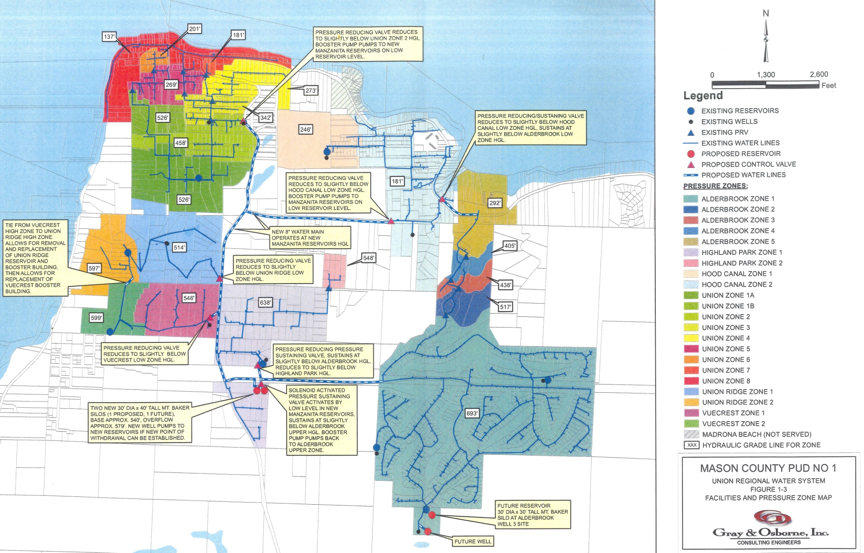
Proposed Consolidated Projects
Notes:
This map shows the proposed improvements for the consolidated water system.

Slide 23
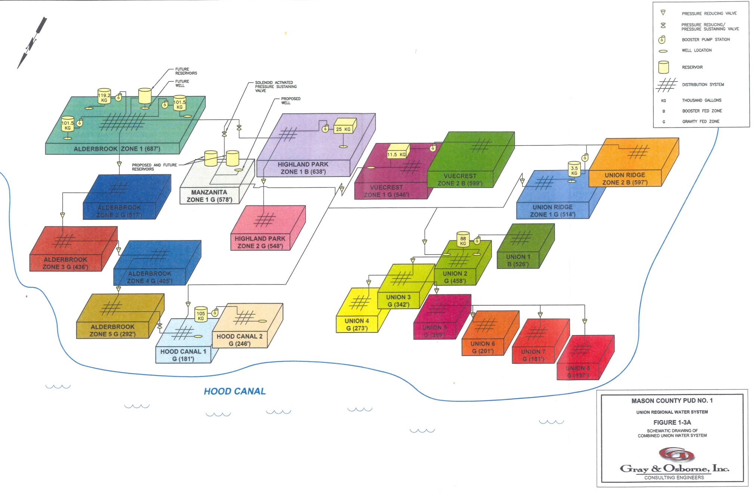
Consolidated Pressure Zones
Notes:
This is a schematic of the pressure zones, wells, tanks, and booster stations. With Union Ridge Zone 2 and Vuecrest Zone 2 combined into a single zone, and Union reduced to eight zones,

Slide 24
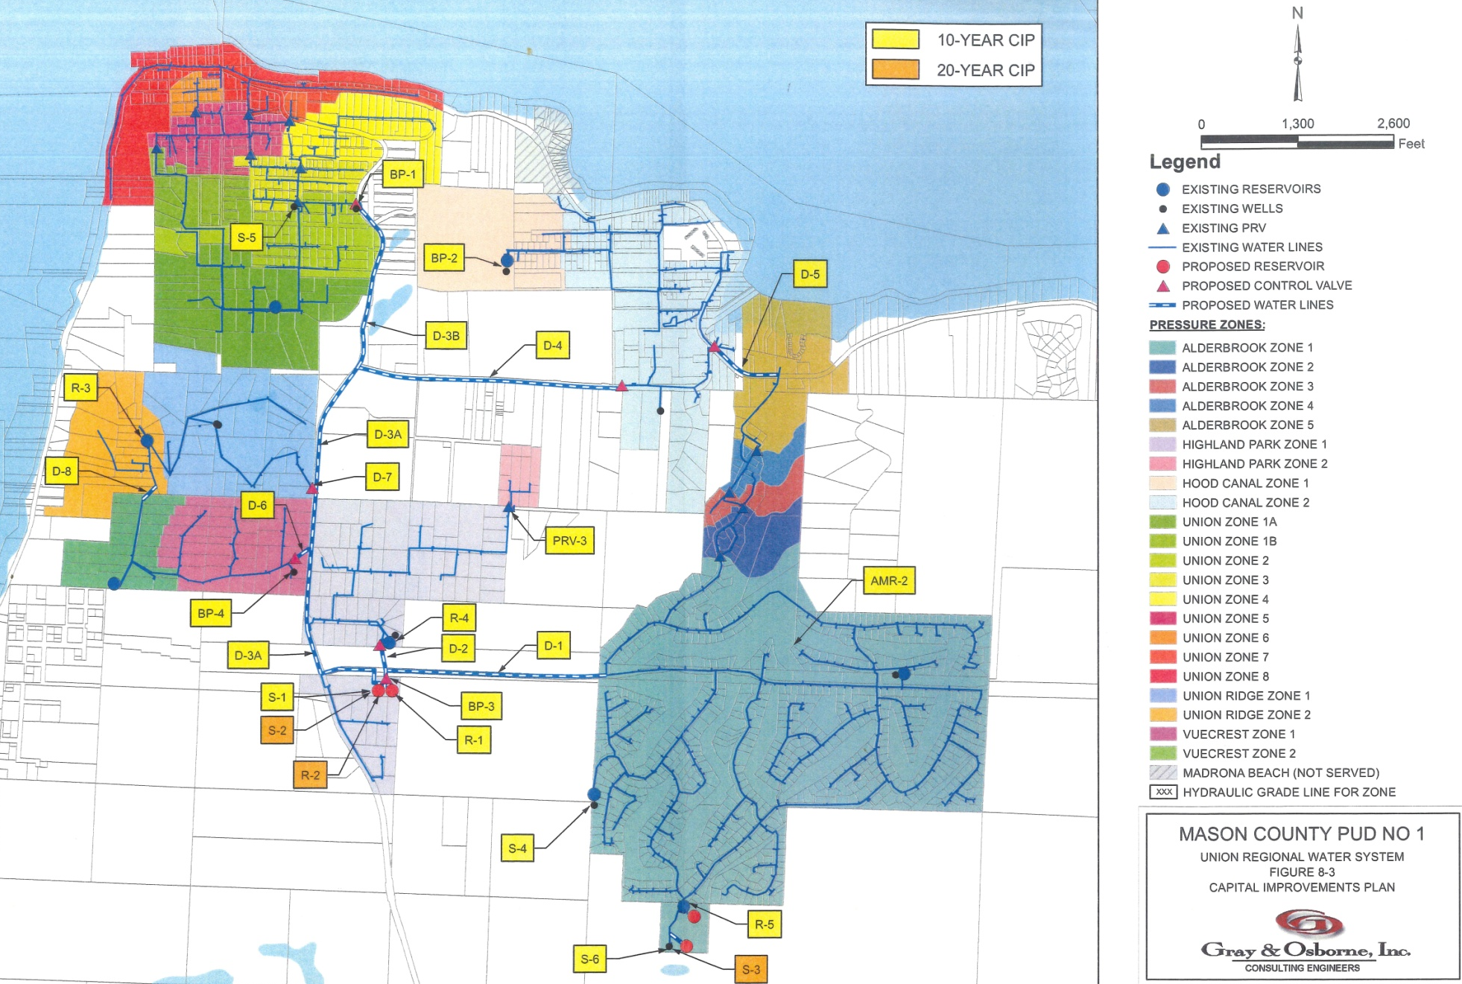
All proposed Capital Improvement Projects over the next 10 years and some stretch into 20 years.

Slide 25
Proposed Project Phasing
First 10 Years
Preconstruction: Historical Review, Cultural Review, Permitting, Engineering Design, and Energy Audit
Begin 2017
Phase 1: Highland Park – Vuecrest – Union Ridge; Reservoir and Booster at Manzanita
Construction 2019
Phase 2: Hood Canal – Alderbrook intertie
Construction 2022
Phase 3: Highland Park/Vuecrest/Union Ridge connection to Hood Canal/Alderbrook via Dalby; Well at Manzanita Site; Booster Station at Hood Canal B Site
Construction 2025 or later
Notes:
Some of the phasing will depend on growth. Phase 1 could be a reservoir and booster station on our Manzanita property to serve Highland Park, Vuecrest, and Union Ridge and a main along McReavy from Manzanita past Arellum and the main between Vuecrest and Union Ridge; these three systems would be consolidated first with a new system name. Phase 2 could be an intertie along SR 106 between Hood Canal and Alderbrook. Phase 3, depending on growth in the area, could be an extension of the McReavy main to Dalby and extend the Dalby main to McReavy to connect the Hood Canal/Alderbrook system to the Highland Park/Union Ridge/Vuecrest system. Phase 3 also includes a well at the Manzanita site and a second booster station at the Hood Canal B well site to meet demand.

Slide 26
Proposed Project Phasing
10 to 20 Years, or More
Phase 4: Loop system via Manzanita – Manzanita Booster Station to Alderbrook; Second Reservoir at Manzanita
Construction 2033
Phase 5: Connect everything to Union; Booster Station at Union Well 2 Site; Booster Station and Well #4 at Alderbrook Well 3 Site
Construction 2037 or later
Notes:
Phase 4 would loop the five systems with the extension of the main on Manzanita from the booster station to Alderbrook and the construction of a second reservoir and corresponding booster station to meet demand.
Phase 5, depending on growth, would extend the McReavy main to the Union Well 2 to tie in the Union Water System, build a booster station at Union Well 2 site, and build another booster station and well at Alderbrook Well 3 site on Vine Maple Lane.

Slide 27
Consolidation Projects
Preconstruction and Phase 1 Projects | Unit Cost | Total Cost | Year
PRECONSTRUCTION: Historical Review, Cultural Review, Permitting, Energy Audit, Engineering Design |  | $120,000 | 2017, 2018
Subtotal Preconstruction: |  | $120,000
PHASE 1: Main from Manzanita Tank to Highland Park | $156/ft | $78,000 | 2019
PHASE 1: Water Main McReavy to Vuecrest | $220/ft | $88,000 | 2019
PHASE 1: Water Main McReavy to Union Ridge | $220/ft | $33,000 | 2019
PHASE 1: Intertie Vuecrest to Union Ridge | $153/ft | $84,150 | 2019
PHASE 1: Booster Station at Manzanita for New Reservoir |  | $314,000 | 2019
PHASE 1: 193,000 Gal Tank at Manzanita |  | $465,000 | 2019
PHASES 1-3: Install Fire Hydrants in Commercial Areas | $6,500/ea | $52,000 | 2019-2026
PHASE 1: Land Acquisition, as needed |  | $250,000 | 2019
Subtotal Phase 1: |  | $1,364,150
Notes:
Preconstruction will design Phases 1 through 3 and perform the historical and cultural reviews for all five phases. Any project that borrows state or federal funds and includes pipe replacement or installation of pumps requires an energy audit. We will begin preconstruction next year as it can take one to two years to get through the historical and cultural reviews. After all the reviews, approvals, and permitting, construction of Phase 1 might begin in 2019. With the construction of the reservoir, booster station, and the several water mains, construction will last 18 to 24 months at an estimated cost of $1.4 million.

Slide 28
Consolidation Projects
Phases 2 and 3 Projects | Unit Cost | Total Cost | Year
PHASE 2: Intertie Alderbrook and Hood Canal via SR 106 | $353/ft | $353,000 | 2022
Subtotal Phase 2: |  | $353,000
PHASE 3: New Manzanita Well | $344/ft | $344,000 | 2025
PHASE 3: Main from Manzanita Booster down McReavy to Dalby Rd (3985 lf) | $240/ft | $956,400 | 2025
PHASE 3: Water Main – Dalby: McReavy to Hood Canal | $240/ft | $919,920 | 2025
PHASE 3: Hood Canal Booster Station Upgrades |  | $239,000 | 2025
Subtotal Phase 3: |  | $2,459,320
Notes:
Phase 2 might begin in 2022 and will only last for a few months at an estimated cost of $350,000. Phase 3 is currently scheduled for 2025 for $2.5 million.

Slide 29
Consolidation Projects
Phases 4 and 5 Projects | Unit Cost | Total Cost | Year
PHASE 4: Water Main – Alderbrook to Manzanita Tank | $240/ft | $720,000 | 2033
PHASE 4: 2nd Tank at Manzanita Site |  | $401,000 | 2033
Subtotal Phase 4: |  | $1,121,000
PHASE 5: Water Main – McReavy: Union Ridge to Union | $240/ft | $956,400 | 2037
PHASE 5: Alderbrook Booster Station #4 for Reservoir #4 at Well 3 Site |  | $75,000 | 2037
PHASE 5: Union Booster Station at Union Well 2 |  | $230,000 | 2037
PHASE 5: Alderbrook Reservoir #4 |  | $465,000 | 2037
PHASE 5: 2nd Well at Manzanita Site | $344/ft | $344,000 | 2037
PHASE 5: Well #4 at Alderbrook Well 3 Site | $344/ft | $344,000 | 2037
Subtotal Phase 5: |  | $2,414,400
Notes:
Phase 4 is expected to be needed in 15 years with an estimated cost of $1.1 million (based on 2016 dollars with 4% annual inflation). Phase 5 will depend on growth in the area, but is scheduled for 20 years from now at an estimated cost of $2.4 million.

Slide 30
Consolidation Projects
Non-Consolidated Related Projects | Unit Cost | Total Cost | Year
Recoat & Reseal Alderbrook Tanks #1 & #2 | $120,000 ea | $240,000 | 2017
Highland Park Tank Repairs |  | $5,000 | 2017
Union Ridge Tank Exterior Recoating |  | $10,000 | 2017
Repaint Well Houses and Booster Stations |  | $16,300 | 2017, 2021
Tank Inspections and Cleanings |  | $45,350 | 2017-2028
Highland Park Well Pump Replacement due to Age | $200/ft | $78,000 | 2018
Rebuild Existing Vuecrest Booster Station |  | $15,000 | 2018
Union Main Line Extensions | $100/ft | $150,000 | 2018-2019
Meter Replacement due to Age – Convert to AMR (Union) | $350/meter | $28,000 | 2019
Brass Meter Replacements for Lead Reduction – Convert to AMR (Union, Highland Park, Alderbrook) | $350/meter | $89,950 | 2019-2020
Main Replacements Due to Age, Other Union Area Systems | $100/ft | $2,120,000 | 2019-2028
Continue on next page…
Notes:
The non-consolidated related projects are the projects that need to be done whether or not consolidation happens. If consolidation does not occur, these projects must be done to maintain the six water systems for the next eleven years.

Slide 31
Consolidation Projects
Non-Consolidated Related Projects | Unit Cost | Total Cost | Year
Fire Hydrant Replacement | $6,500/ea | $52,000 | 2020
Fire Hydrant Repair & Maintenance | $1,000/ea | $57,000 | 2020, 2025
Service PRV Installations due to High Pressures | $606/ea | $3,636 | 2020
Alderbrook Main Replacement due to Age | $110/ft | $770,000 | 2020-2028
Main Line PRV Replacements |  | $11,000 | 2022-2024
Water System Plan Updates | $30,000/ea | $60,000 | 2022,2028
Separate Golf Course from Domestic Water |  | $500,000 | 2024
Union Well 1 Pump Replacement due to Age | $200/ft | $33,200 | 2024
Union Well 2 Pump Replacement due to Age | $200/ft | $59,600 | 2024
Alderbrook Well 1 Pump Replacement due to Age | $200/ft | $58,400 | 2027
Alderbrook Well 3 Pump Upgrade for Capacity | $200/ft | $52,400 | 2027
Non-Consolidated Related Projects Subtotal: |  | $4,454,836
Notes:
These required projects add up to $4.5 million over eleven years.

Slide 32
Estimated Project Costs
Phase | Total | Connect | $/Connect
Preconstruction | $120,000 | 859 | $140
1 | $1,364,150 | 131 | $10,413
2 | $353,000 | 513 | $688
3 | $2,459,320 | 644 | $3,819
4 | $1,121,000 | 644 | $1,741
5 | $2,414,400 | 859 | $2,811
Consolidated Total: | $7,831,870 | 859 | $9,117
Non-Consolidated Related | $4,454,836 | 859 | $5,186
Grand Total: | $12,286,706 | 859 | $14,303
Notes:
The five phases and preconstruction over twenty years add up to $7.8 million. Add in the non-consolidated related projects and the total capital improvement plan is estimated at $12.3 million over 20 years.

Slide 33
11 Year Capital Improvement Plan
Phase | Total | Connect | $/Connect
Preconstruction | $120,000 | 859 | $140
1 | $1,364,150 | 131 | $10,413
2 | $353,000 | 513 | $688
3 | $2,459,320 | 644 | $3,819
Consolidated Total: | $4,296,470 | 644 | $6,672
Non-Consolidated Related | $4,454,836 | 859 | $5,186
Grand Total: | $8,751,306 | 644 | $11,858
 |  | 215 | $5,326
Notes:
The 11 year capital improvement plan includes preconstruction, Phases 1 through 3, and the non-consolidated related projects for a total of $8.75 million. Since Union will not be connected to the other five systems during the first 11 years, it will have a different cost per connect. The other five systems are looking at costs of nearly $12,000 per connection while Union customers will have costs of $5300 per connection. These costs are all projected and subject to change depending on when we start the project, the type of funding. We will review rates and capital surcharges next year for all water systems.

Slide 34
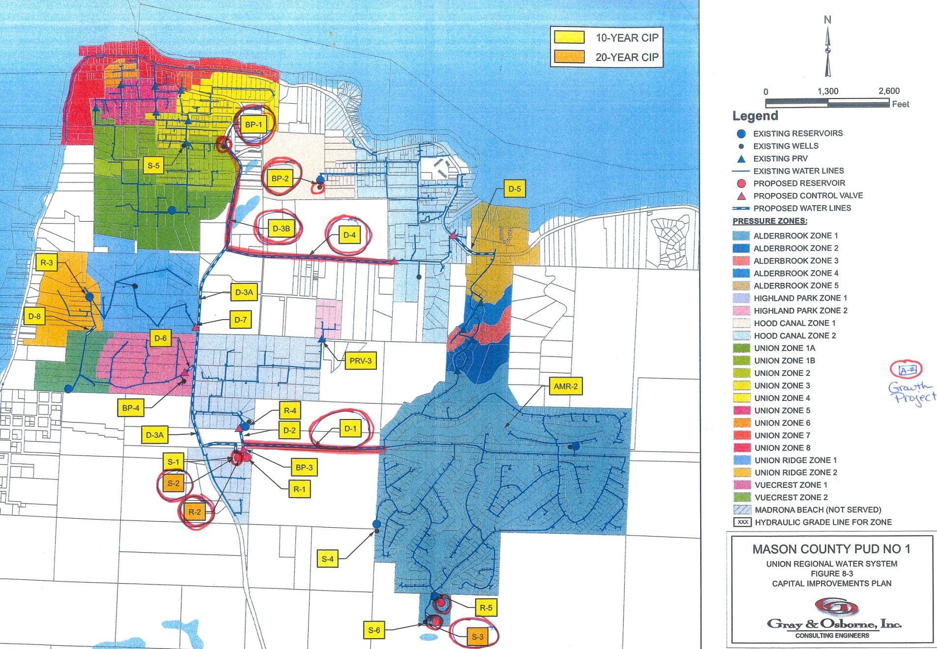
Circled projects are for growth only.
Notes:
The projects circled in red and the mains in red are for growth only. If growth does not occur, the projects can be delayed.

Slide 35
Final Outcome
A single recognized water system – Union Water System
Three distinct areas isolated with control valves:
Union
Union Ridge – Vuecrest
Highland Park – Hood Canal - Alderbrook

Slide 36
